Slide 1

Dynamics data in Synapse Link for Dataverse - Transitioning from Export to Data Lake to Synapse Link (Deepdive)
Jila Yadav, Principal Solution Architect, Microsoft Dynamics
in/JJYadav
Steven Koppens, Senior Solution Architect, Microsoft Dynamics
in/steven-koppens-4026bb3
Milinda Vitharana, Principal Product Manager, Microsoft Dataverse
in/milindav
Aman Nain, Senior Solution Architect, Microsoft Dynamics
in/amannain
Rich Black, Senior Solution Architect, Microsoft Dynamics
in/blackrich

Slide 2
Purpose of this deck
Speaker: | In-house Specialist, Microsoft Spokesperson or Partner (Leader/Exec/SME)​
Audience: | IT Solution Architect, Data and BI Professionals
Title: | Transition to Synapse Link – Deep dive on architecture patterns
Length & Version: | 60 minutes, last updated Dec 2023
Content Level: | Level 300 for external & internal use
Deck Contacts: | Microsoft Product team: Jila Yadav, Milinda Vitharana, Jason Huang, Rich Black, Steven Koppens, Aman Nain
Desired Outcomes: | Clear understanding of different architecture patterns that customers have adapted with Export to data lake, steps required to transition to Synapse Link. Proof of concept or planning workshop with an inhouse specialist, Microsoft Services or Partner
Usage Guide: | Slides should be adaptive to the specific audience situation – feel free to reorder slides, hide slides, etc. that you feel fit with your audience and the products they currently use.
Notes:
The purpose of this presentation is to provide you with an example of how best to present this Level 300 pitch deck to technical architect and . This external facing deck is intended to provide deep dive on transition from export to data lake to Synapse link.
For your reference, every slide has comprehensive notes that you can review later. The notes are intended to guide you during customer conversations, so you are empowered with accurate talking points and relevant statistics. Included in the deck are additional industry use cases and features coming soon that you can leverage.

Slide 3
If you are using Export to Data lake today…
… check out the TechTalk series on this topic also!
Tables folder
(Virtual data warehousing)
Talk #2
Synapse &
Microsoft Fabric
(Lakehouse architecture)
Talk #4
Overview
Talk #1
Upgrade to Synapse Link*
Low code insights & action
Change feeds
(Cloud data warehousing & incremental ingestion)
Talk #3
https://aka.ms/TransitiontoSynapseLinkVideos

Slide 4
Agenda
Transition to Synapse Link (Overview)
Architecture pattern & transition guidance
Virtual Data warehousing with Synapse Link
Explore Lakehouse architecture with Synapse link
Incremental data integration
BYOD replacement
Explore Link to Microsoft Fabric
Call to action
Appendix

Slide 5
Transition
1
Upgrade to Synapse Link
Business benefits
Expected effort and timelines
Notes:
Synapse Link is now fully compatible with finance and operations data, so customers can use this guidance to help transition from Export to Azure Data Lake. In this section, we'll examine what's changing, why the transition is important, what are the expected benefits, and how much effort may be entailed.

Slide 6


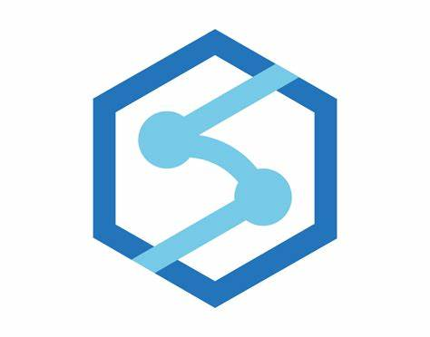
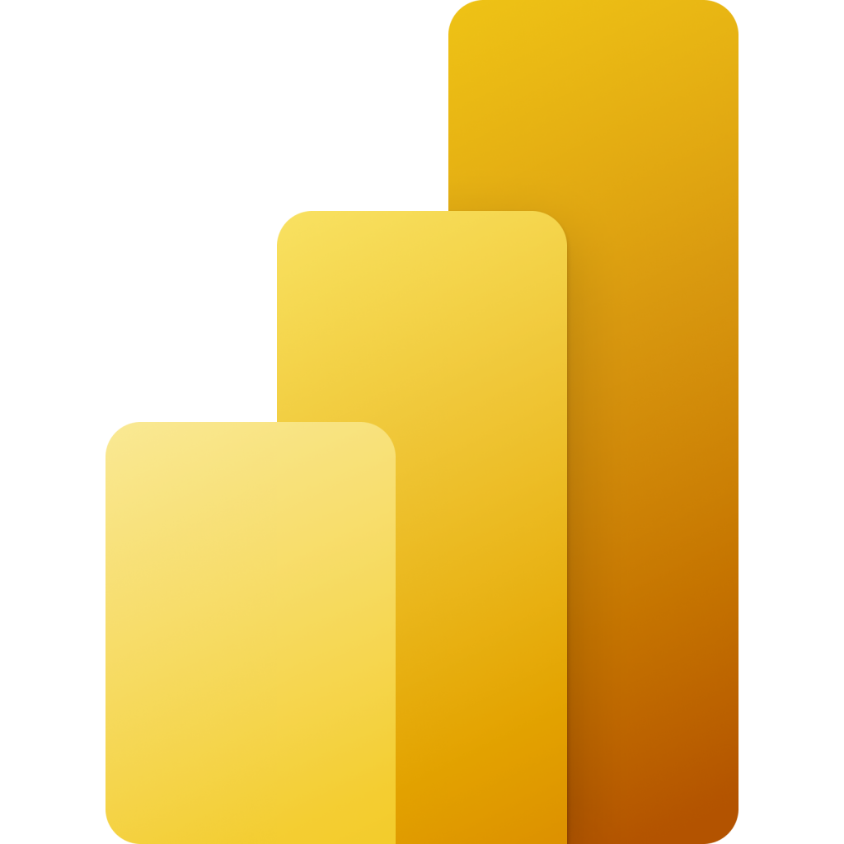

Previously : Synapse Link & Export to Data Lake
Synapse Link for Dataverse
Export to Data lake
Dynamics 365 Finance & Supply chain
Synapse Analytics helps working with data using SQL and other tools
Power BI for data visualization and story telling

Slide 7
One experience to integrate all Dynamics data for Analytics
Synapse Link for Dataverse
One experience to integrate all your data for Analytics
Synapse Analytics helps working with data using SQL and other tools
Power BI for data visualization and story telling
This is an evolution and unification of our approach across Dynamics products

Slide 8

Unlock AI driven insights and action with Link to Fabric
Dataverse Link to Fabric
One experience to integrate all your data for Analytics
Microsoft Fabric combines Synapse Analytics, Power BI and more into a single, unified experience on the cloud
Upgrading to Synapse Link provides a path to innovations in Microsoft Fabric

Slide 9
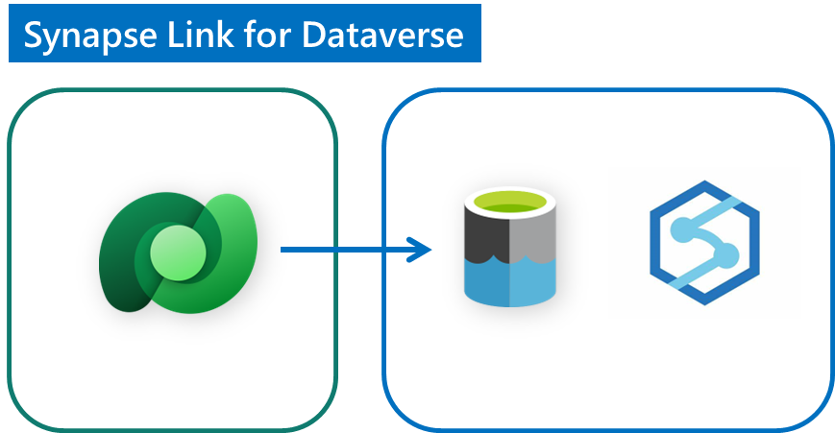
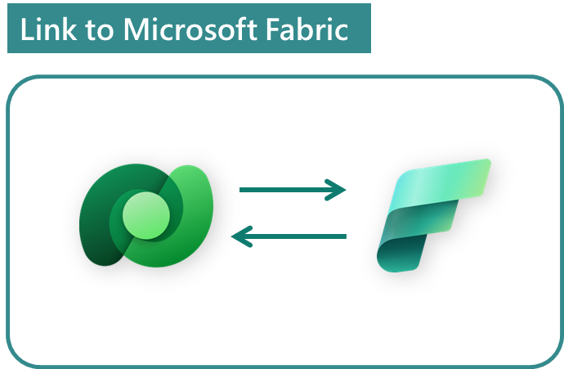
Extend your investments to AI driven insights & action
This is an evolution and unification of our approach across all Dynamics products
Legacy data integration services
Data Export Service (DES)
Bring your own DB (BYOD)
Export to Data Lake
Generally available
Generally available
Upgrade to Synapse Link*
Low code insights & action
Simplify data integration & Reduce total cost of ownership
Data shapes remain the same – no need to re-build
No-ETL, no-copy, two-way integration enables Low code makers
AI driven insights & action with built-in Copilots
* Existing customers have until 1-Nov-2024 to transition from Export to Data lake to Synapse Link. We advise new customers to use Synapse Link

Slide 10
Architecture patterns and transition
2
Common analytics architecture patterns and transition strategy from export to data lake to Synapse link and Microsoft Fabric

Slide 11
Overview of common analytics architecture patterns
#1 Virtual data warehousing
(Reading data from data lake using TSQL views and SPs)
# 2 Lakehouse
(Reading and transforming data using spark notebooks)
# 3 Integration using TSQL to Azure/On-prem SQL, Synapse Dedicated pool or On-prem
(Incremental ingestion of data to relational DB (SQL Server), Cloud DW (Synapse Dedicated pool) or third party DW
Click on the links above to go to the relevant section.

Slide 12
Virtual data warehouse
3
How you can upgrade your virtual data warehouse from Export to Data lake to Synapse Link

Slide 13
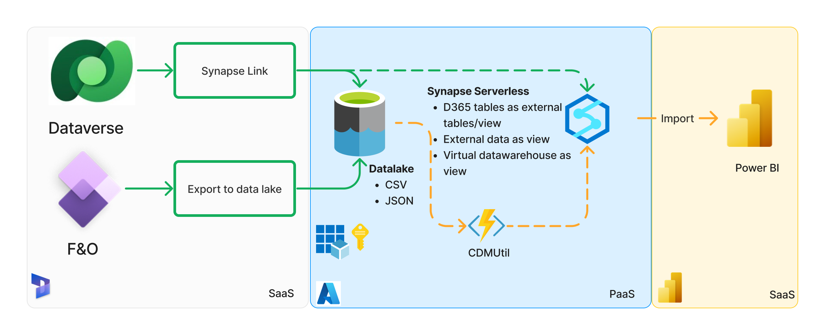
Virtual data warehousing: Synapse Link & Export to data lake, with Synapse Serverless
Previous pattern

Slide 14
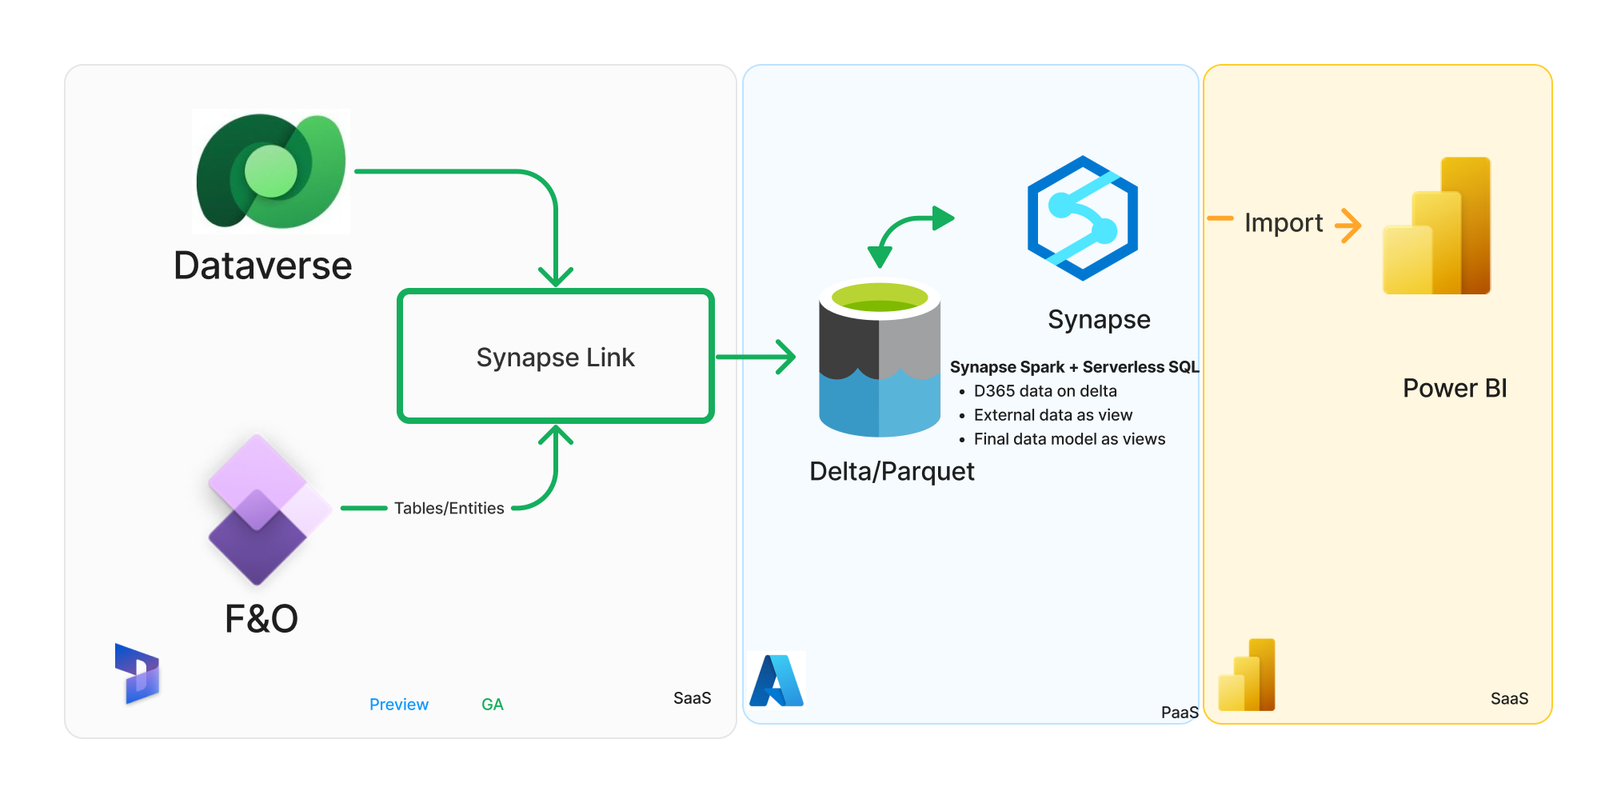
Virtual data warehousing : Synapse Link (BYOL) with Synapse Spark & Serverless
New pattern with Synapse Analytics
Notes:
Simplified user experience to export all Dynamics 365 data
Secure storage account with MSI access
Convert F&O Tables on CSV with delta – Better perf and lower query cost
Transition to Fabric with ease using DV Fabric shortcuts

Slide 15
Step-by-step: Transition virtual data warehousing using Synapse Spark +Serverless
Prerequisites
Extract Synapse serverless objects, use SSDT tool to automate. (Other than F&O tables views created by CDMUtil)
Setup Synapse Link for finance and operations apps data: Link
Configure Azure Synapse Workspace and Spark Pool Link
# | Steps
1 | Create a new SQL database in Azure Synapse Serverless
2 | Create VIEWs in the new database for tables/entities
3 | Deploy additional objects on new database
4 | Update downstream applications to new serverless db
5 | Validate end-to-end solution
Tool to get started quickly:
DataverseLink/VirtualDatawarehouse
Considerations
When creating the VIEWs within the serverless database you can add audit column names as those in the Export to data lake feature, this will reduce the effort on updating pipelines etc… that use those columns.

Slide 16
Upgrade to Synapse Link: Total cost of ownership
A cost comparison for Operational reporting with near-real time reporting*
 | Export to data lake | Synapse Link for Dataverse
Start-up & configuration - Additional software licenses - System configuration - Data migration/initialization - Development and validation |  | Simpler configuration experience
Operating Costs - Data integration - Azure storage staging area - Data pipelines - Data ingestion into SQL or Dwh - Development/ maintenance | Azure storage Synapse Analytics (SQL query) Data Factory jobs SQL or Data warehouse storage Mts. of data pipelines | Azure storage costs - ~60% less due Synapse analytics (spark) - +$300-$3,000 mo*
Operating Costs – Reporting - Power BI datasets - Reporting | Synapse analytics (SQL Query) Power BI capacity

Slide 17
Operational reporting cost comparison
 | Export to data lake (CSV) | Synapse Link for Dataverse (Delta)
Data storage | Total DB – 615 GB Varies by table, ex. INVENTTRANS: 1.3GB | Total: 98 GB (6x compression) INVENTTRANS: 360MB (6x compression)
Operating Costs – data integration | Data Factory jobs SQL or Data warehouse storage Mts. of data pipelines | Synapse analytics (spark) - +$300-$3,000 mo*
Operating Costs – Query and reporting | Synapse query - $10,630 /month (1) | Synapse query - $ 1,701 /month (2) (6x reduction)
NOTE 1: Synapse Query charges based on total data processed, which in this case was 2,126 TB (@$5/TB)
NOTE 2: 10x query cost reduction due to
10x data compression
Delta/parquet format is more efficient Partition elimination

Slide 18
Lakehouse architecture with Synapse Link
4
Build Lakehouse architecture with Synapse Link

Slide 19
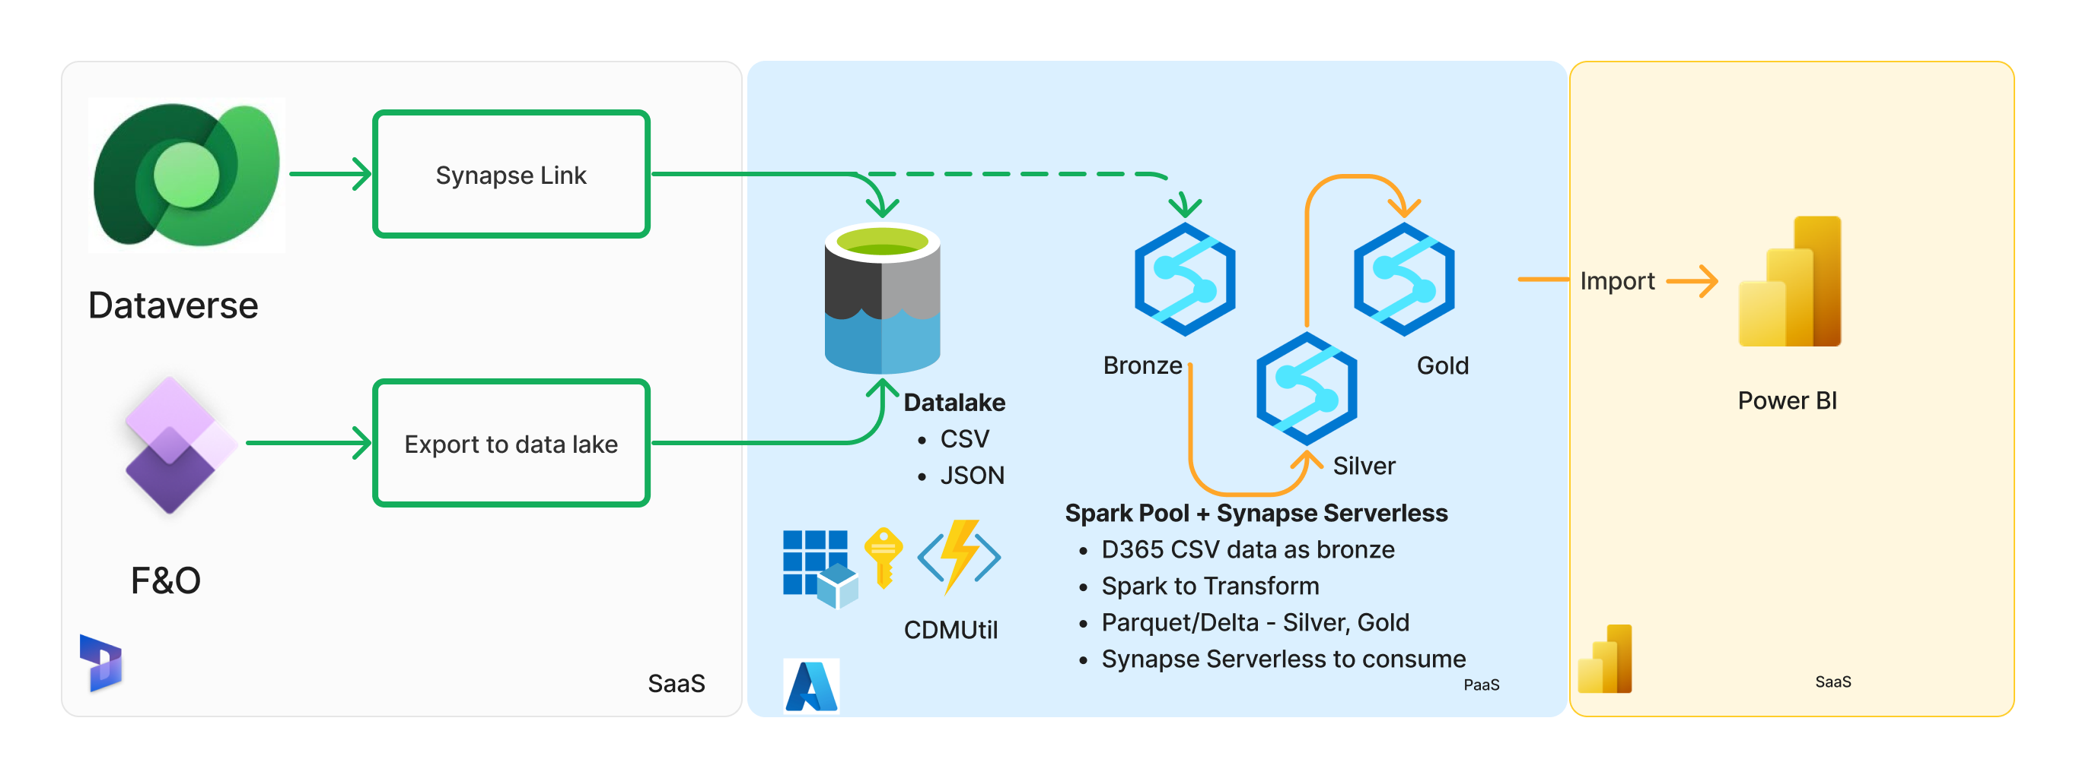
Lakehouse : Synapse Link/Export to Data lake, with Synapse Spark & Serverless
Previous pattern

Slide 20
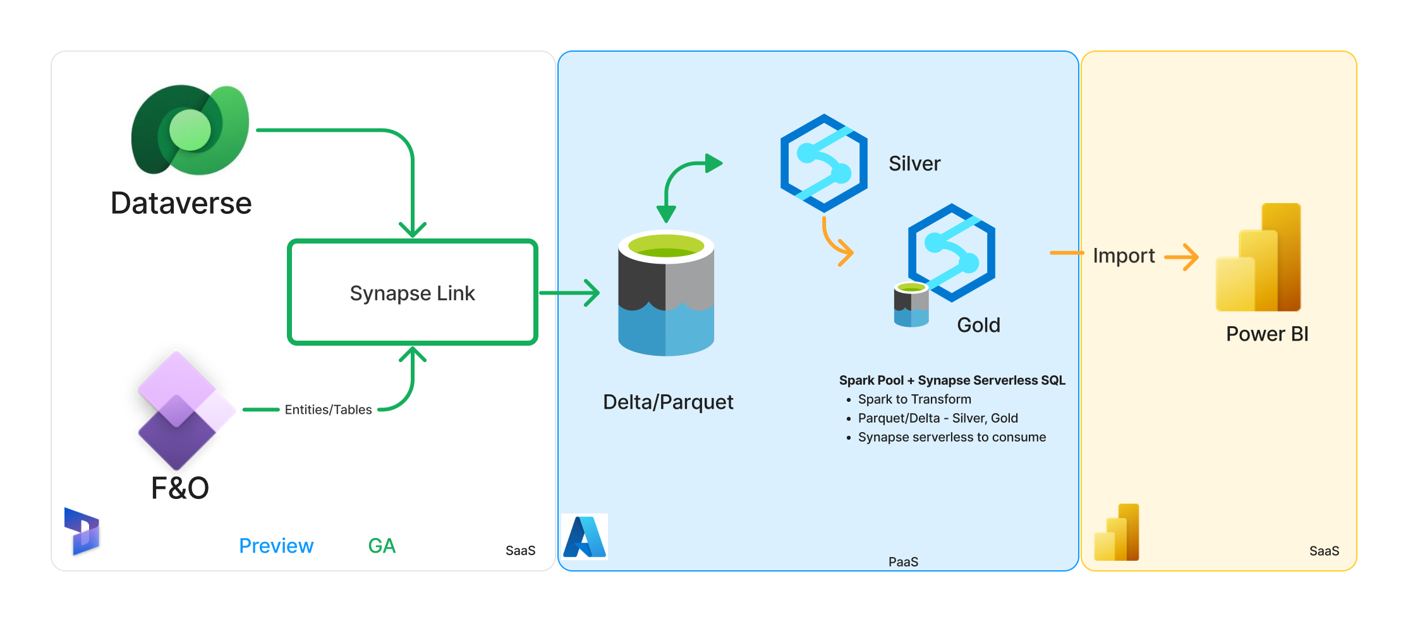
Lakehouse : Synapse Link (BYOL), with Synapse Spark and Serverless
New pattern

Slide 21


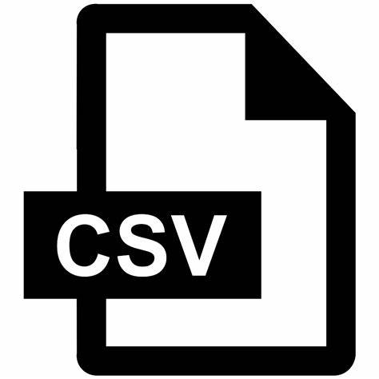

Lakehouse : Synapse Link (BYOL), with Databricks
Export to data lake
(F&O Tables)
Bronze
Synapse Link
(DV Tables+ F&O Tables + Entities)
Silver
Synapse Spark
Gold
New pattern

Slide 22
What are the benefits – deep dive
Area | What is changing | Effort | Value add
Admin and setup experience | LCS to Power platform maker portal for setup and add tables | Admin user training | Data from all Dynamics apps available in a simple experience
Tables available to use | Tables must have row version change tracking enabled Common OOB already enabled | One-time small X++ effort to extend missing OOB or custom tables | # of table limit is not applicable Default support for large memo fields
Change tracking mechanisms | CDC to Row version change tracking | No effort | Lower impact on operational database Full refresh is not needed to recover from failure/Database failovers/ movements
Integration with Synapse and Microsoft Fabric | No need of CDMUtil | Saved effort | Configures & connects Synapse workspace and Microsoft Fabric
Data format | Data format changes from CSV to delta lake BYOL – Customer Synapse Spark for delta conversion | No effort | Faster queries, smaller files, no update conflicts Integrated with Microsoft Fabric data platform for the age of AI
Data transformation/ETL | Adapt to any small audit field changes in ETL and data locations as applicable | Low effort to adapt
Incremental data Integration | Adapt to Synapse link folder structure and audit fields and incremental logic | Low effort – adjusting the incremental pipelines to new New Pipleline available on Github | Failover does not require full push Simpler logic to process full and incremental data with single pipeline
Lakehouse architecture | No need to convert CSV to Parquet or Delta |  | OOB delta conversion Metadata available in Synapse Lake database
BI & Reporting | No change expected

Slide 23
Incremental Data Integration with TSQL
5
Incremental data integration with TSQL

Slide 24
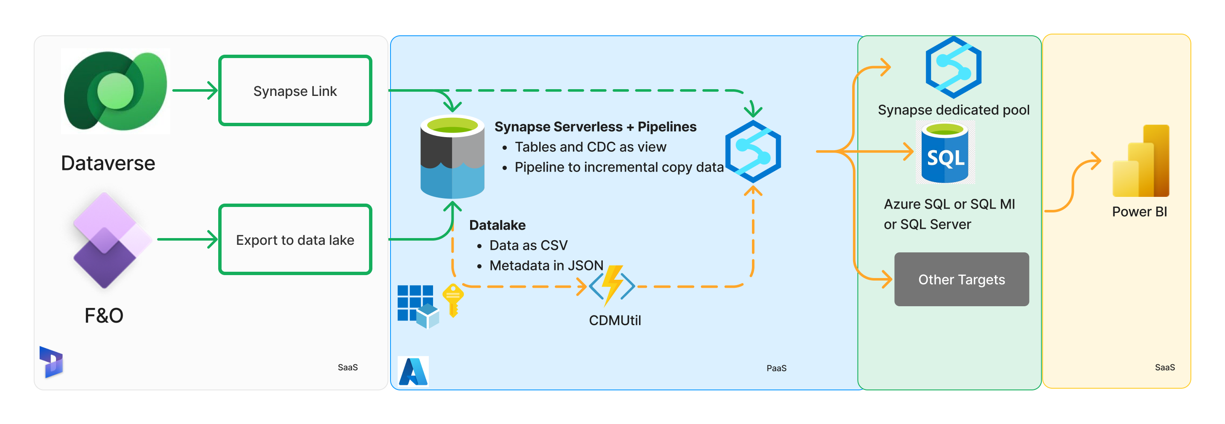
Integration using SQL: Synapse Link/Export to Data lake with relational cloud or on-prem databases using Synapse
Old pattern

Slide 25
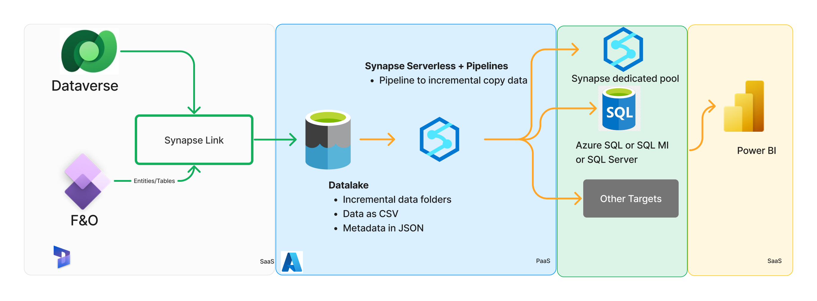
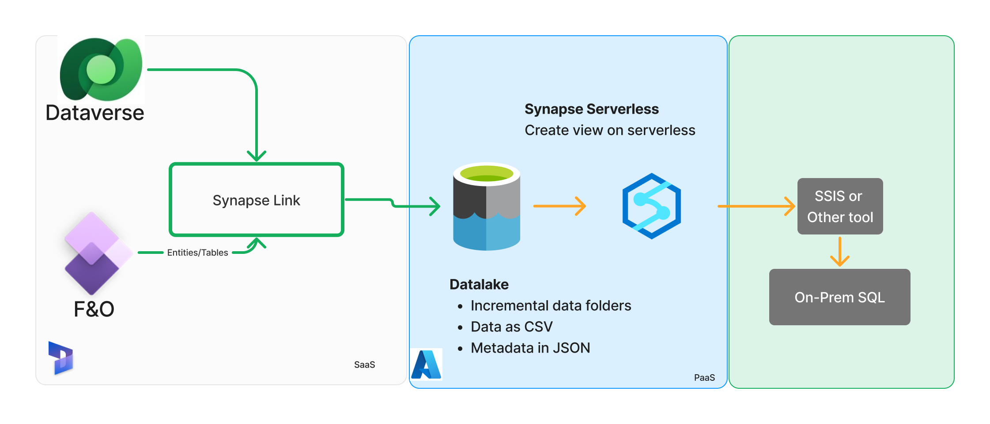
Integration using SQL: Synapse Link/Export to Data lake with relational cloud or on-prem databases using Synapse
New pattern

Slide 26
Step-by-step: Incremental data ingestion using Synapse Serverless and Pipelines
Prerequisites
Setup Synapse Link for finance and operations apps data: Link
Configure for incremental folder update feature Link
# | Steps
1 | Create synapse workspace and serverless SQL database.
2 | Create views on Synapse serverless db for table/entities on incremental folders
3 | Create ADF/Synapse pipeline to read new folders, copy incremental data from serverless views, de-duplicate and merge data to target database
4 | Schedule pipeline to periodically copy incremental data
5 | Validate existing ETL logic on the target SQL database
Tools to help:
/DataverseLink/DataIntegration

Slide 27
Comparing – ChangeFeed(Old) vs Incremental folder (New)
 | ChangeFeed | Incremental
File path to schema | <container>/ChangeFeed/<table name>.cdm.json | <container>/<folder name>/model.json Folders are named by creation timestamp ("yyyy-MM-dd'T'HH:mm:ss.SSSz") in UTC.
File path to data | <container>/ChangeFeed/<table name>/<file name>.csv | <container>/<folder name>/<table name>/<filename>.csv
Changed data identification | Use the Modified datetime on the individual CSV files | Use the name of the folder and model.json size does not equal 0
Column differences | Detailed here | Detailed here
Full push | Old files within <container>/ChangeFeed/<table name>/ deleted and new files created after table initialised | All records sync’d to latest folder <container>/<folder name>/<table name>/<filename>.csv
Additional details | ChangeFeed folder feature | Incremental folder feature

Slide 28
BYOD Replacement with Synapse Link
6
BYOD Replacement with Synapse Link

Slide 29
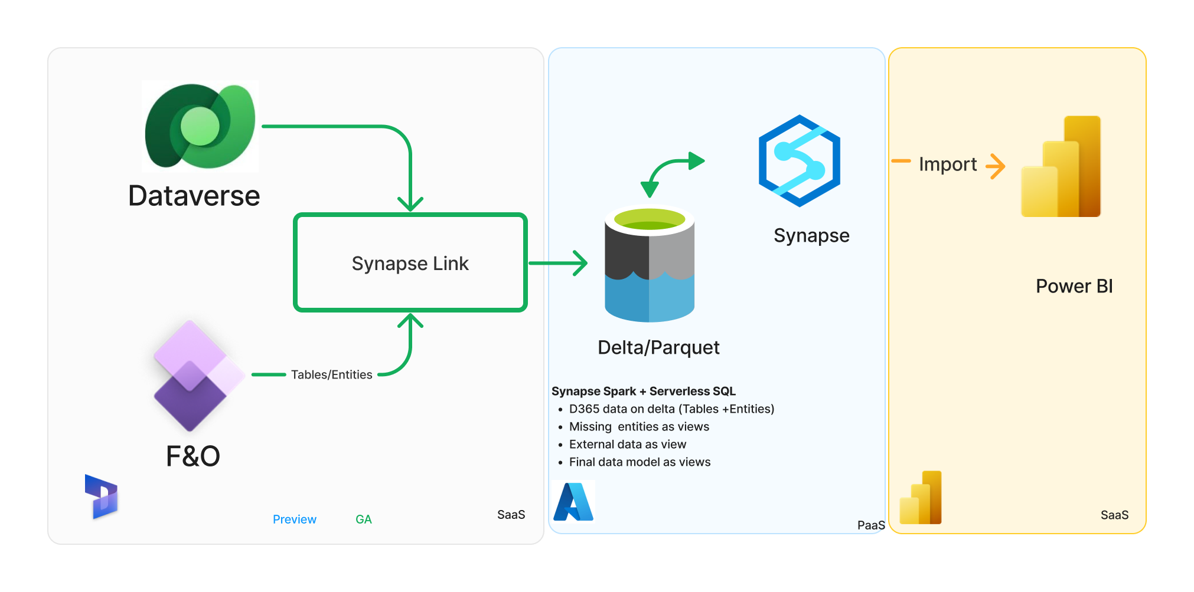
#5 BYOD Replacement with Synapse link

Slide 30
Link to Microsoft Fabric
7
Overview of Dataverse Link to Microsoft Fabric
Notes:
Product roadmap is subject to change and dates provided are estimates.

Slide 31
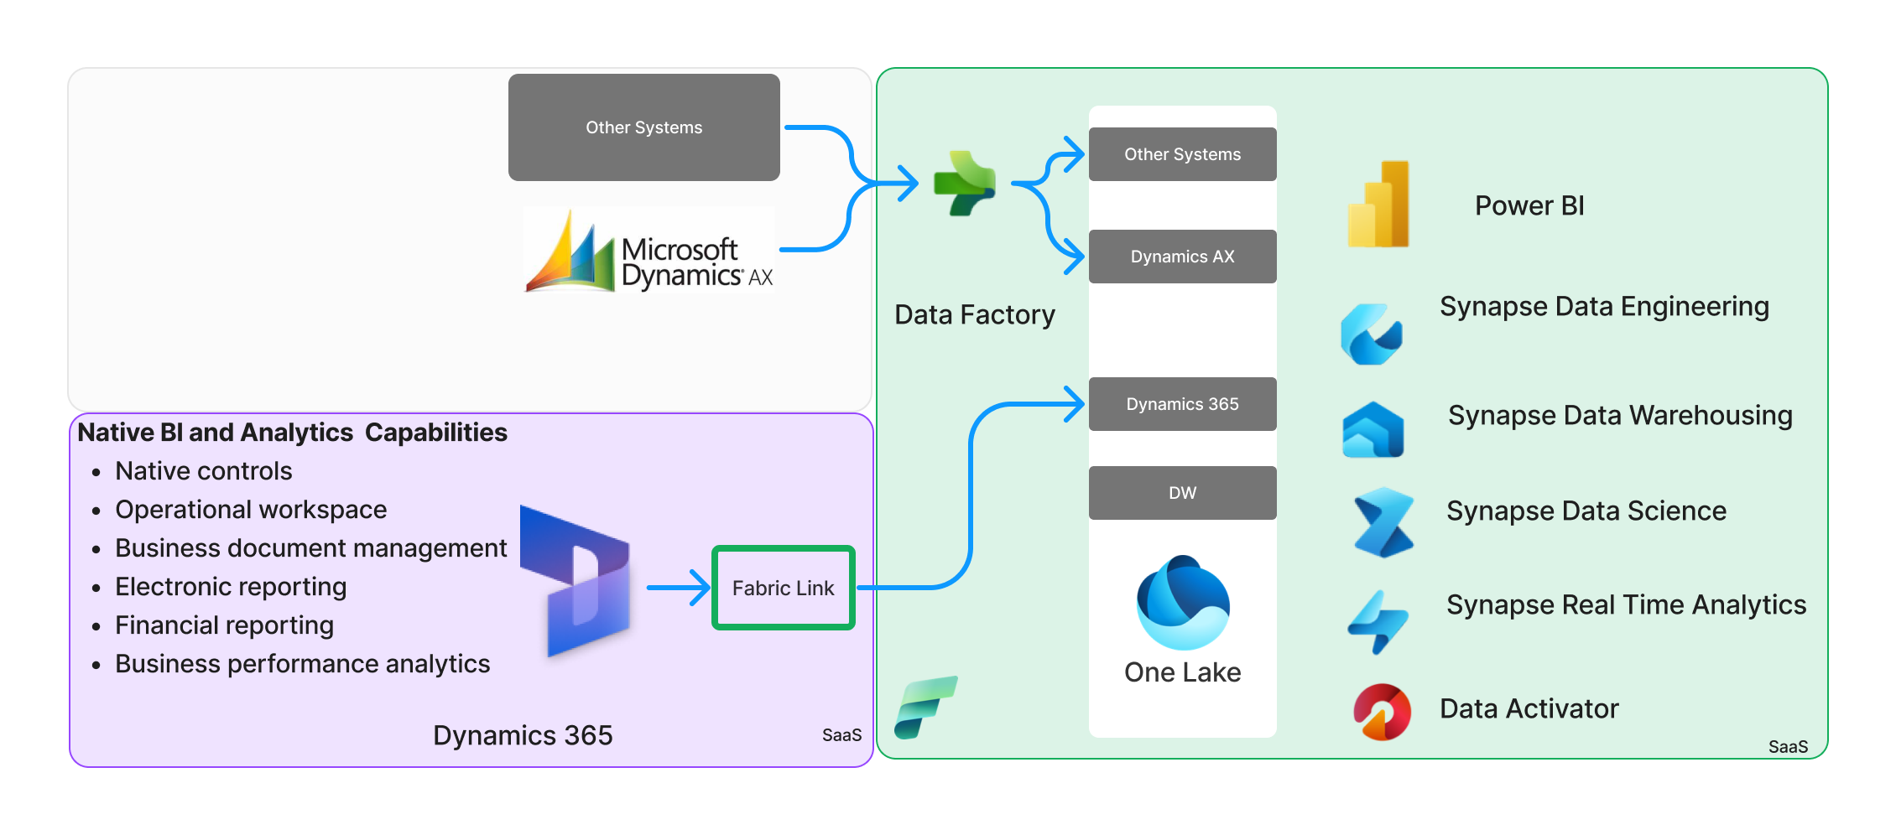
Unlock AI driven insights and action with Link to Fabric

Slide 32
Demo: Link to Microsoft Fabric
For extensive demos, check out the TechTalk series on this topic at
https://aka.ms/TransitiontoSynapseLinkVideos

Slide 33
Appendix
8
Product screen shots and details
Documentation

Slide 34
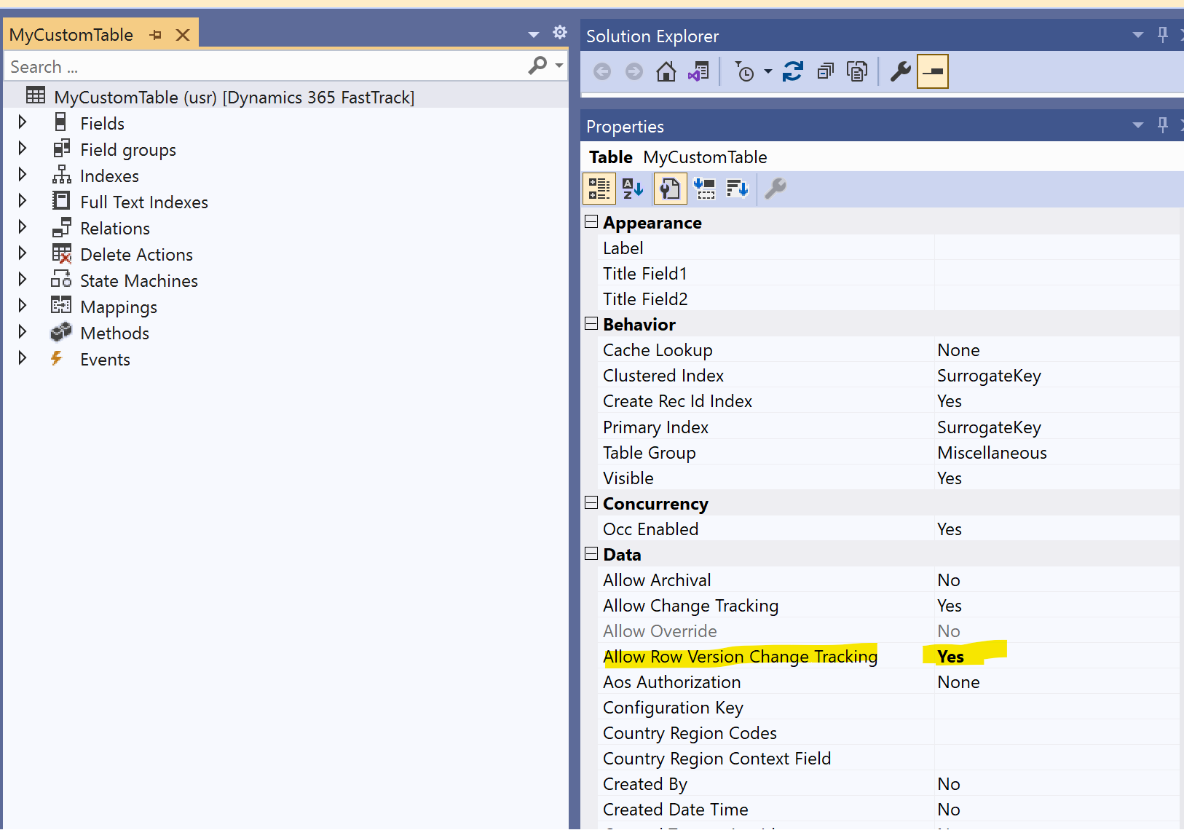
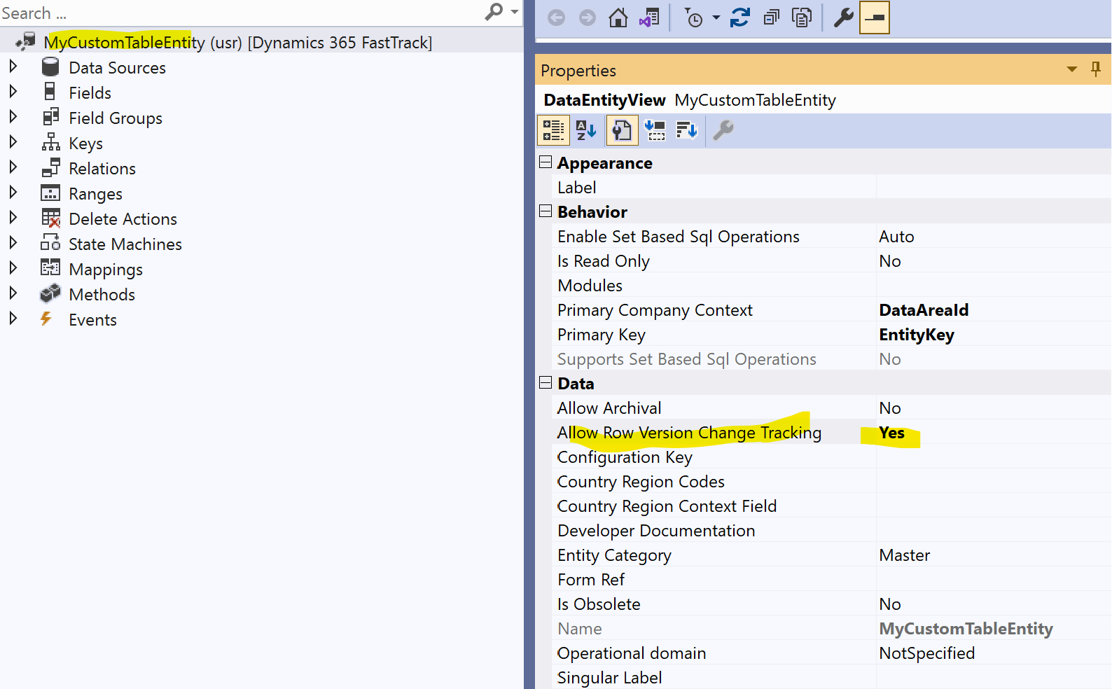
Allow Row Version Change Tracking
Row version CT property must be enabled on tables
2400+ OOB tables already have it enabled (most common used with Export to data lake)
Row version CT property is extensible – Developer can extend the property for any tables that is not enable OOB
Custom and ISV tables needs a property enabled on table to make it available (one-time small dev work)
Notes:
Change a single property to export custom tables and entities. Set Allow Row Version Change Tracking to Yes.

Slide 35
CSV vs Delta lake
Factor | CSV | Delta Lake
File Size & Storage Efficiency | Text format, larger file size, no built-in compression | Columnar format, smaller file size, built-in compression
ACID Transactions | Not supported, may lead to data corruption during write failures | Supported, ensures data integrity
Performance | Slower read/write due to row-oriented storage | Faster read/write due to columnar storage and statistics
Data Virtualization | Less efficient due to performance and schema evolution limitations | More efficient due to performance optimizations and schema evolution support
Data Processing (Transformation) | Not optimized, longer processing times, higher resource usage | Efficient supports data processing
Schema Evolution | Schema changes may require data rewriting (Export to data lake – support schema drift on new column) | Built-in support for schema evolution
Metadata Handling | No built-in metadata handling, managed separately. Export to data lake manage metadata using cdm.json | Built-in metadata handling alongside data
Compatibility | Widely supported, easy to use with various tools and platforms | Open-source data format – widely used for BI and Analytics workload.

Slide 36
Comparing incremental change technology
Feature/Aspect | CDC (Export to data lake) | Change tracking (BYOD) | Row version CT (Synapse link)
What it captures | Changes (Inserts, Updates, Deletes) with historical data. | Which rows have changed (Insert, Update, Delete) without historical data. | Changes via a version column; doesn't provide historical data.
Overhead | Low to Moderate. | Low to Moderate. | Low. Only the version number increments.
Storage | Stored in change tables separate from the original table. | Metadata only, so less storage overhead. | Additional integer column in the table for the version.
Query Mechanism | System functions and change tables. | CHANGETABLE function. | Standard SQL queries using the version column.
System Impact | Log and IO impact on due to the logging of changes. | Querying with CHANGETABLE on large dataset with extended time can cause blocking. | Minimal impact; only an increment operation.
Recovery from failure/Failover /DR | Full export if CDC retention period is missed, Failover or Disaster recovery | Full export if CT retention is missed | Changes are retained in the database- No full export needed

Slide 37
Data sync state column differences
Synapse link | Description | Equivalent columns in Export to data lake
Id | Unique value for each row like RecId, generated to for compatibility between F&O and CE platform | Not applicable
SinkCreatedOn | Datetime stamp when the data is written to datalake | DataLakeModified_DateTime
SinkModifiedOn | Datetime stamp when the data was updated in delta lake | DataLakeModified_DateTime
 |  | LastProcessedChange_DateTime
versionnumber | The versionnumber column is an automatically incremented binary number, that updates every time a row is inserted or modified in a table. Can be used as marker for incremental data processing. | LSN
isDelete | Rows that are hard deleted in the source will be marked as isDelete = true in the incremental CSV file. | NA

Slide 38
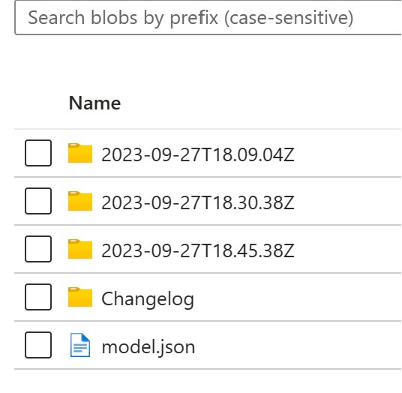
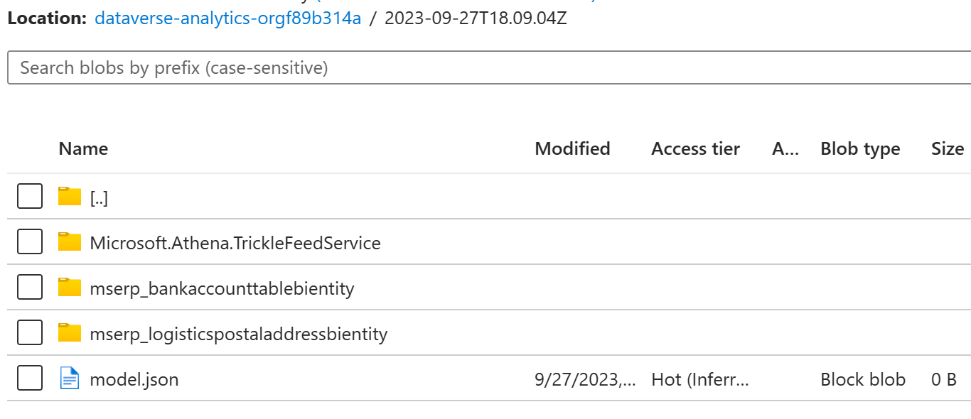
Understanding – Incremental folder
Incremental folder feature
An Incremental profile is created in maker portal with storage account only
When table is added to incremental folder profile, system start initial export, when complete, table is marked as Active.
In Active state, incremental changes in the tables copied to data lake in near real time.
Initial data as well as incremental data follows the same pattern and folder structure in the data lake.
Folder created with name creation timestamp with format "yyyy-MM-dd'T’HH.mm.ss.SSZ“
Inside the timestamp folder, child folders are created with format “{tablename}” that contains csv data.
While data export starts a file model.json file is created with 0 bytes. You should not read the data from the folder, until model.json file is updated.
Once data write complete/update frequency is reached (example 15 min), model.json file is updated with tables metadata under the timestamp folder to mark completion of the folder.
Once previous folder is complete, a new folder get created and process continues.

Slide 39
Incremental folder data processing - Ideas
Type | Trigger point | Pre-Processing | Data read | Data copy | Post processing
Event based | Storage event – when model.json file under timestamp folder is updated size not 0 Pass the {timestampfolder1} |  | Read each tables {ftimestampfolder1}/{tablename} CSV data | De-duplicate the data on VersionNumber and ID Upsert the rows matching or ID Delete the rows where IsDelete = True
Batch mode | Specified time interval | Create a high watermark marker – foldername Identify list of folder completed since last watermark {folder1,folder2} | Read each folder {folder1}/{tablename} , {folder2}/{tablename} folders CSV |  | Update marker with largest timestamp foldername processed

Slide 40
Known issues, gaps, workarounds and timeline as of Dec 2023
# | Workaround | Fix ETA
Missing columns in table like custtable, (AOS validation, Array fields ) |  | Jan
Date Effective tables: expired rows are not exporting |  | TBD
Missing columns in table like DirPartyTable | Create a view and join base tables and derived table

